Slide 1
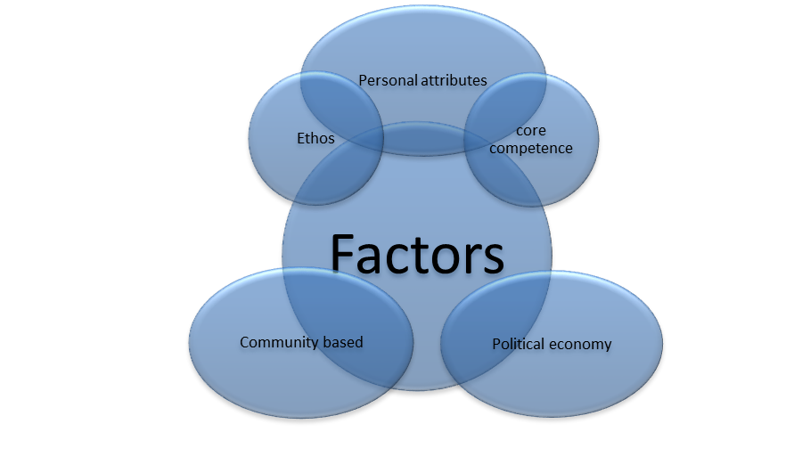
Old version

Slide 2
New version
editable
Personal attributes
Ethos
Core competence
Factors
Community based
Political economy

